Slide 1
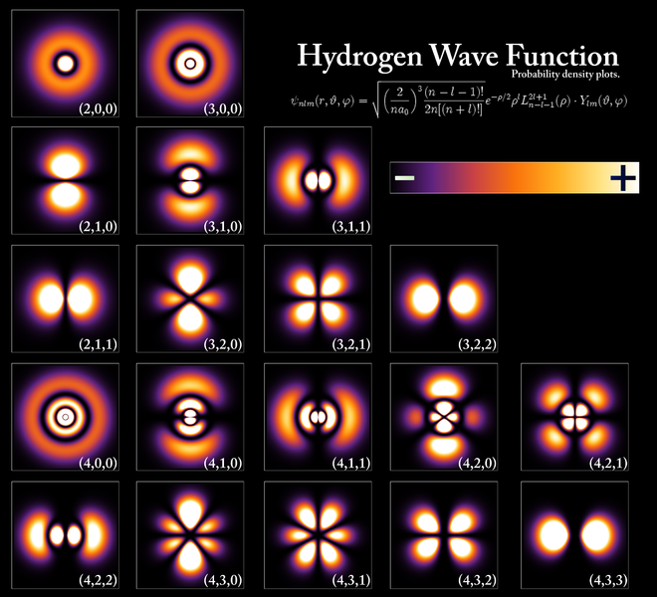
Lecture 7: Hydrogen atom wavefunctions

Slide 2
The Hydrogen atom problem in spherical polar coordinates
n = 1, 2, 3…
l < n
l=0,1,2,3…
|m|< l
m=0, ±1, ±2, ±3, ±4,….

Slide 3
Energy and Angular Momentum
n = 1, 2, 3…
l < n
l=0,1,2,3…
|m|< l
m=0, ±1, ±2, ±3, ±4,….

Slide 4
Radial and angular parts
n = 1, 2, 3…
l < n
l=0,1,2,3…
|m|< l
m=0, ±1, ±2, ±3, ±4,….

Slide 5
H-Atom: Three Quantum Numbers
n = principle
quantum no
l = Azimuthal
quantum no
m_{l} = magnetic
quantum no
3 Quantum Numbers needed to describe the 3D system completely
Unlike PIB three Quantum Numbers are INTER-RELATED in H-Atom

Slide 6
How to obtain normalized Ψ_{n,l,m}(r,θ,φ)?

Slide 7
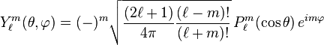
Complete Wavefunction of H-Atom
Lets not get intimidated: Please do not even try to remember

Slide 8
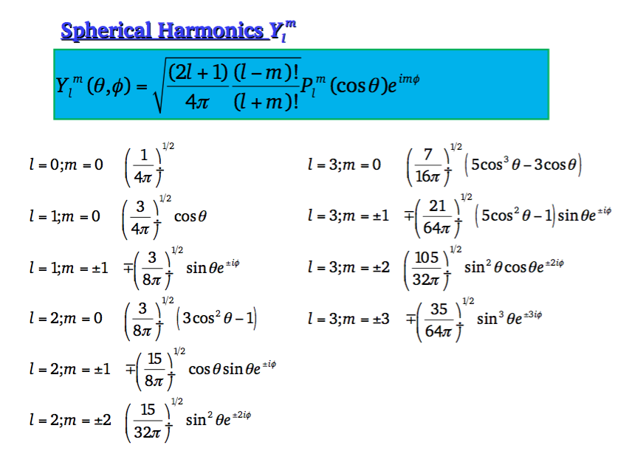

Slide 9
Radial Functions (of Hydrogen Atom)
Number of radial nodes =
n-l-1

Slide 10
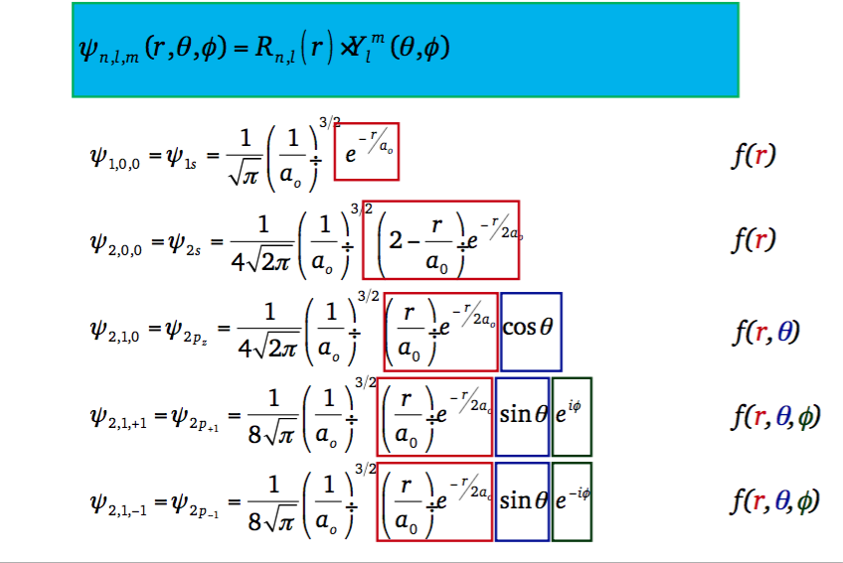
H-Atom Complete Ψ(r,θ,φ) for n=1,2
Note: R_{nl}→0 as r→infinity

Slide 11
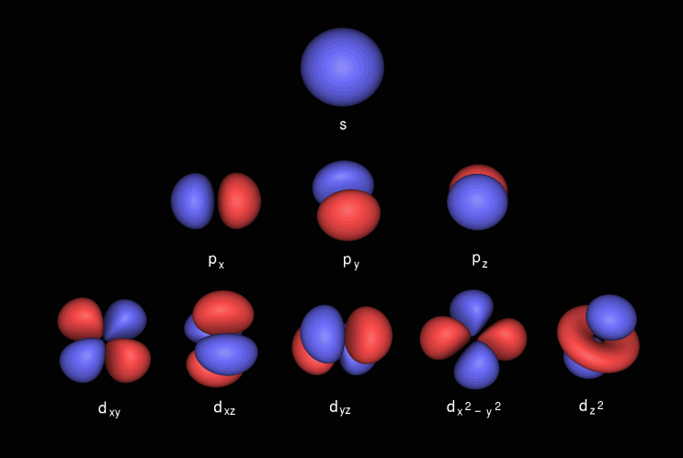
So, what is an orbital?
Are these what chemists refer to as pictures of “Orbitals”?
Definition:“Orbital” is an 1-electron wavefunction

Slide 12
H-Atom Complete Ψ(r,θ,φ) for n=1,2
1s and 2s Orbitals
Note: R_{nl}→0 as r→infinity
Functions of only ‘r’

Slide 13
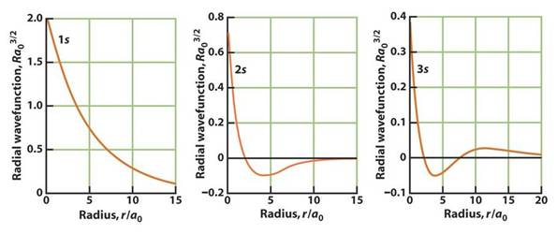
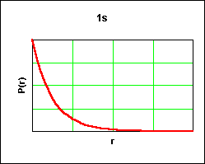
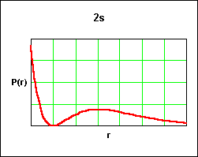
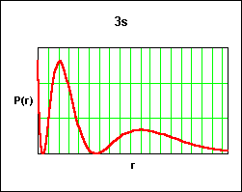
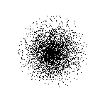
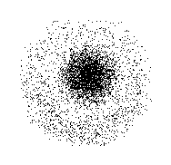
S-Orbitals (l=0,m_{l}=0)” R_{nl} and R_{nl}²
For s-Orbitals the maximum probability density of finding the electron is on the nucleus: Maximum probability of finding the electron?

Slide 14
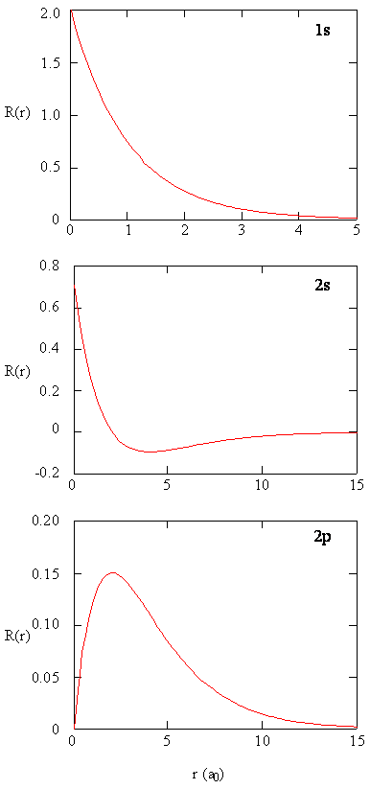
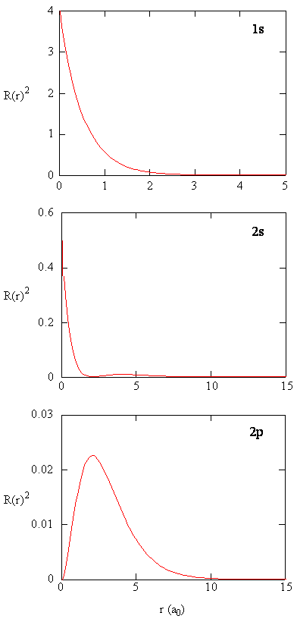
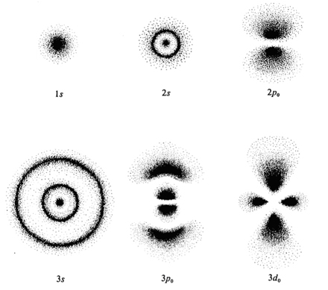
Radial functions
for H-Atom for n=1,2
For s-Orbitals the maximum probability density of finding the electron is on the nucleus
Maximum probability of finding the electron?

Slide 15
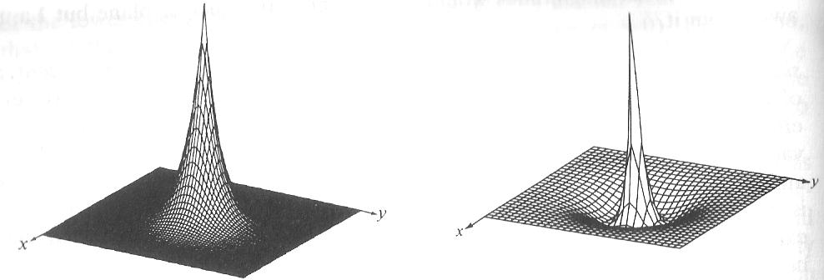
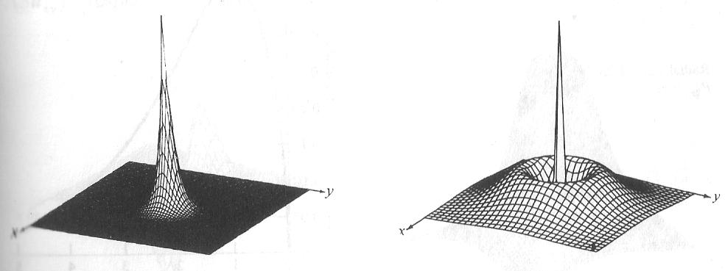
Surface plot of Ψ and Ψ² for S
1S
2S
(1S)²
(2S)²
Maximum probability of finding the electron?

Slide 16
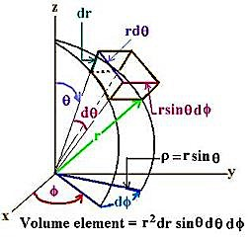

Probability: Volume element in spherical polar coordinates
For a s orbital
2
2π
Radial Probability distribution function

Slide 17
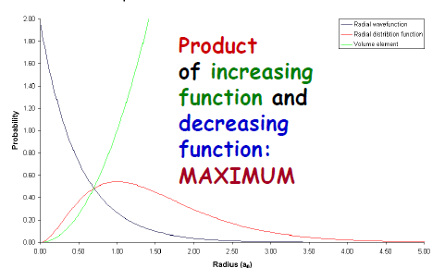
Radial Distribution Functions : Probability
For s-Orbitals :
Maximum probability density of finding the electron is on the nucleus
Probability of finding the electron on the nucleus zero

Slide 18
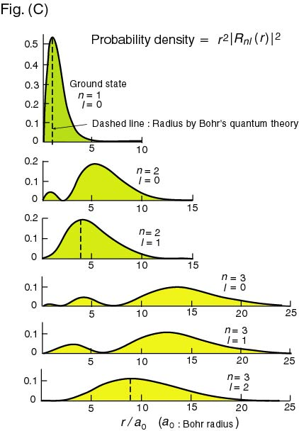
Radial Distribution Functions

Slide 19
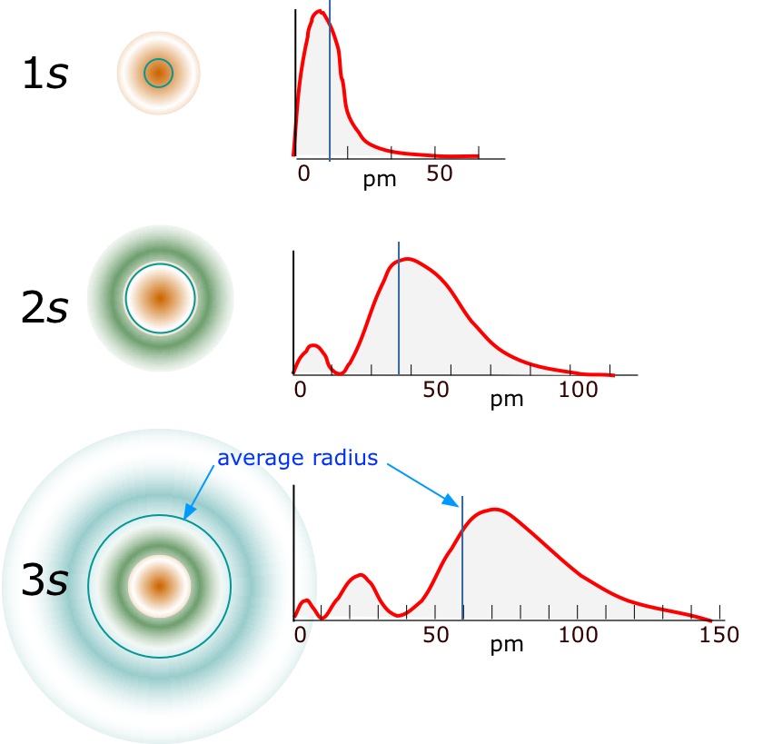
Radial Distribution Functions: 4πr²R_{nl}²(r)
Number of Radial Nodes
is always n-l-1
3s: n=3, l=0
Nodes= 2
3p: n=3, l=1,
Nodes= 1
3d: n=3, l=2
Nodes = 0
N=1, l=0
N=2, l=0
N=3, l=0

Slide 20
H-Atom Complete Ψ(r,θ,φ) for n=2
2p Orbitals
Functions of ‘r’, ‘θ’ and ‘φ’

Slide 21
2p Orbitals
Linear
combination

Slide 22
Radial functions
for H-Atom for n=1,2
2p Orbitals
For s-Orbitals the maximum probability density of finding the electron is on the nucleus

Slide 23
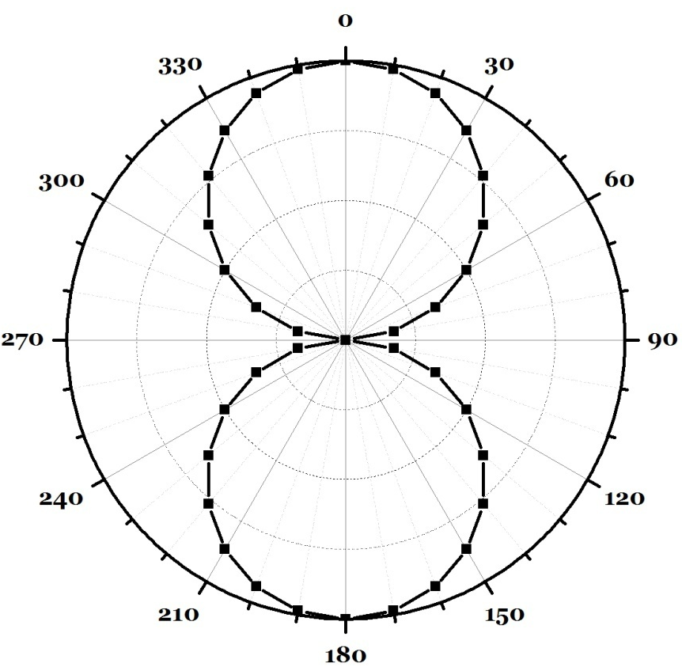
Angular Functions?
p-Orbitals
Angular part: Polar plot of 2p_{z} --- cosθ
θ | cosθ
0 | 1.000
10 | 0.985
20 | 0.940
30 | 0.866
40 | 0.766
50 | 0.643
60 | 0.500
70 | 0.342
80 | 0.174
90 | 0.000
120 | -0.500
150 | -0.866
180 | -1.000

Slide 24
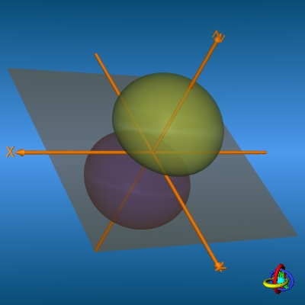
Complete Rotation around z-axis

Slide 25
Misinterpretation of Orbital pictures
Angular plots of Ψ(θ,φ) has no physical meaning – just mathematical functions - may be used to obtain information about probable electron distribution.
But can not be, in any way, regarded as the “picture” of an orbital. It is unfortunate that fuzzy drawings like these are often incorrectly represented as “orbitals”
However, ψ² might provide a better intuitive picture
Definition:“Orbital” is an 1-electron wavefunction

Slide 26
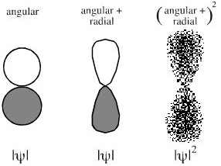
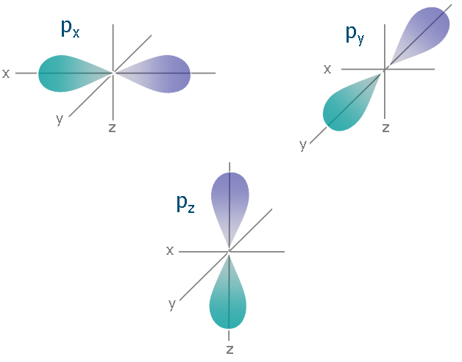
(Angular x Radial) Electron Densities
x
x

Slide 27
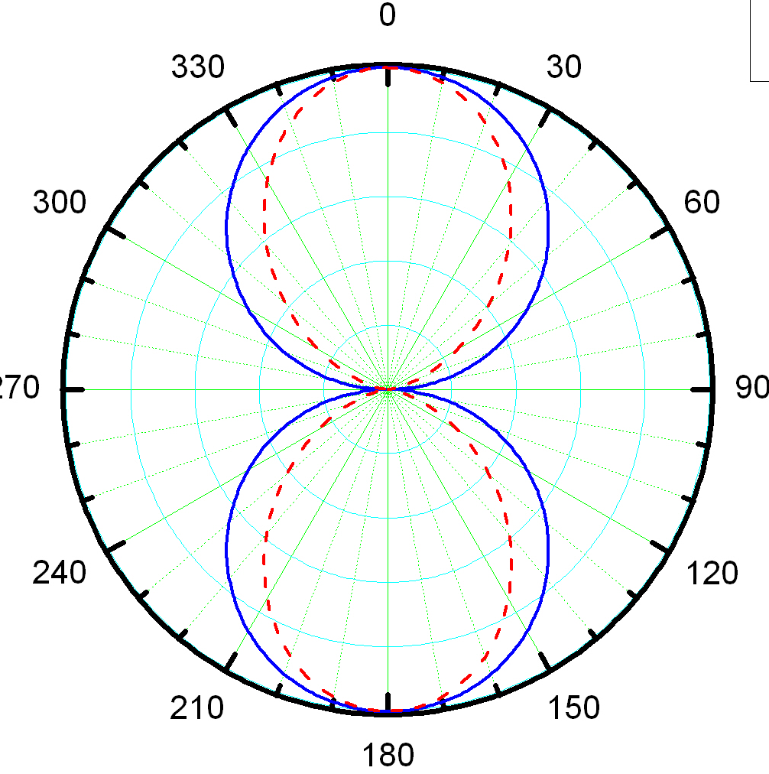
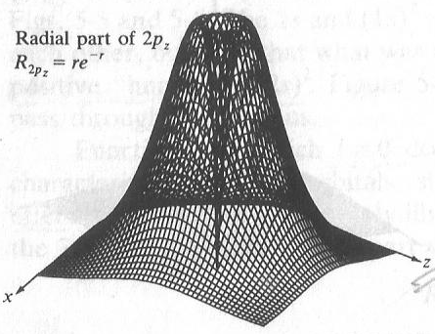
Surface plot of Ψ_{2pz} = (re^{-r})x(Cosθ)

Slide 28
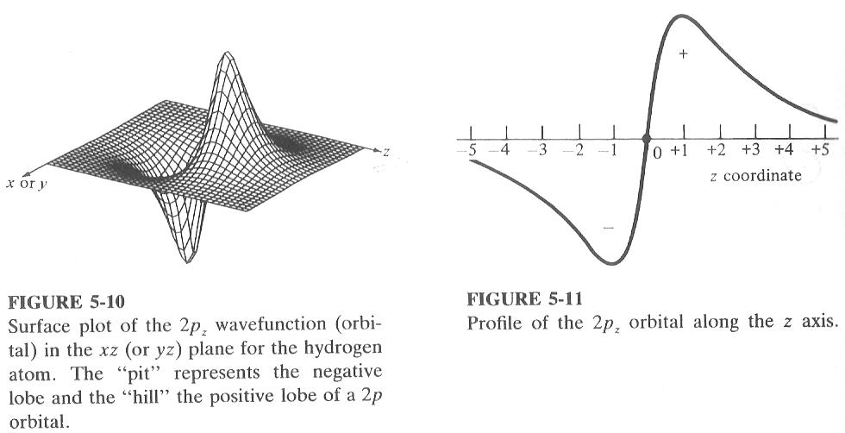
Surface plot of Ψ_{2pz} = (re^{-r})x(Cosθ)
One 3D projection
of 4 dimensional plot
(Φ is constant)
One cross section

Slide 29
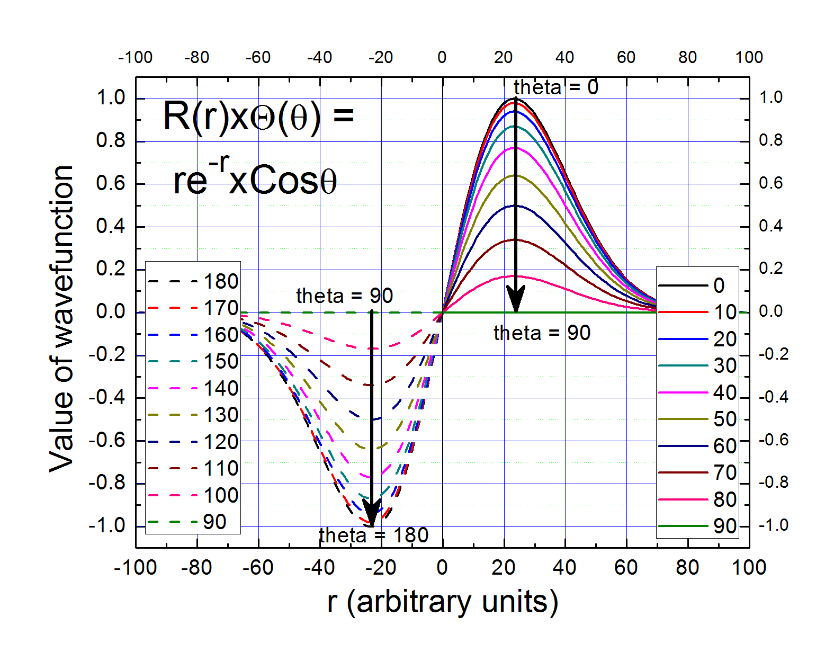

Slide 30
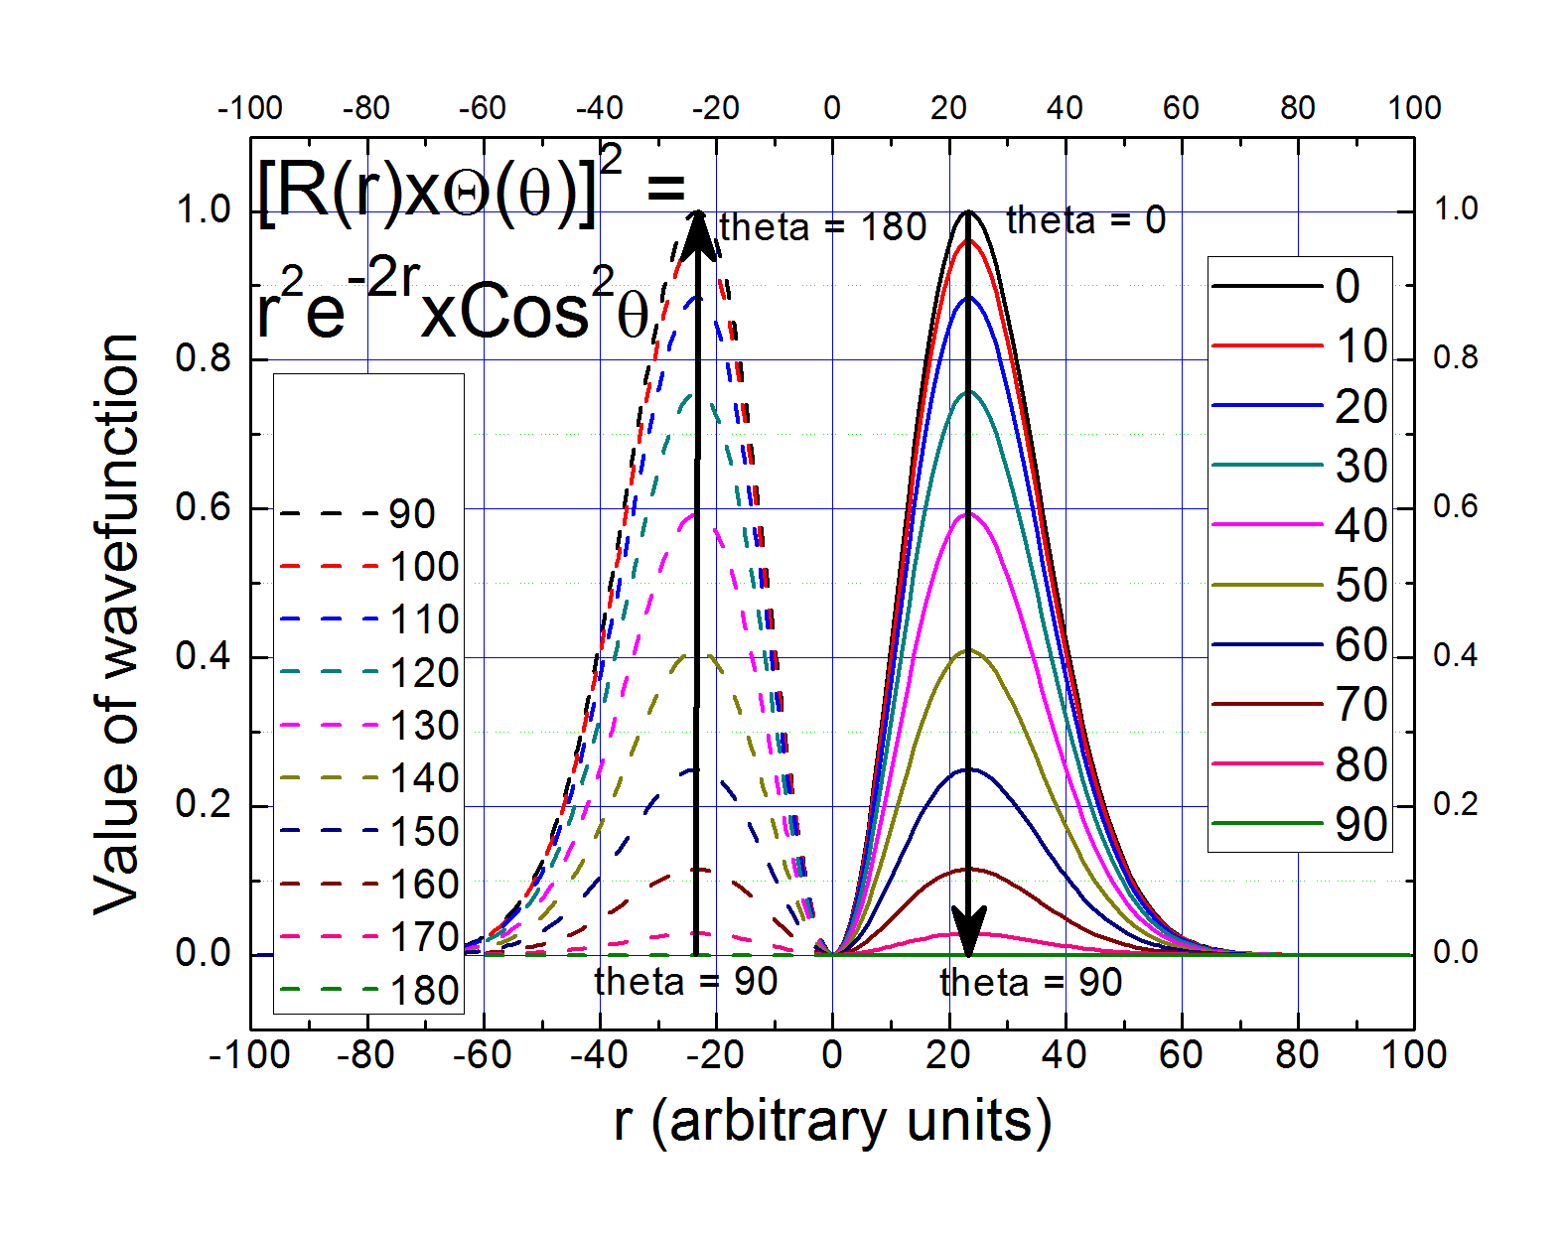

Slide 31
Surface plot of Ψ_{2pz} = (re^{-r})x(Cosθ)

Slide 32
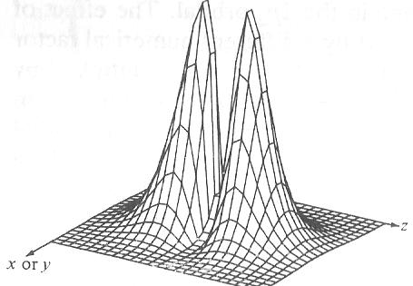
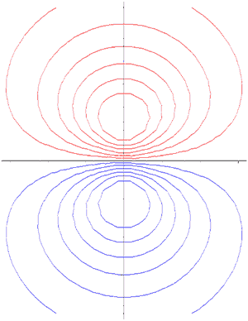
Surface plot of Ψ²_{2pz}~(r²e^{-2r})x(Cos²θ)
In books, or in class, one of the low valued
probability density contour are shows as “Orbitals”

Slide 33
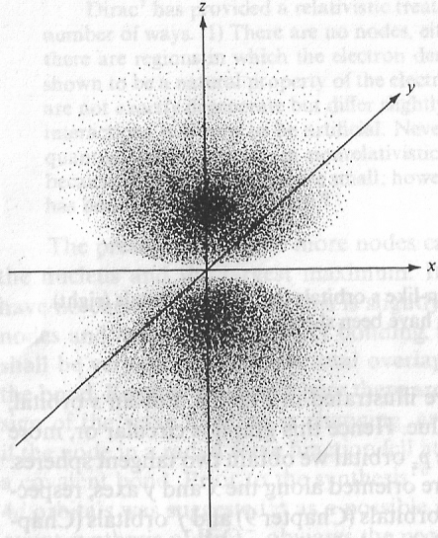
Contours of constant probability density → Distribution of electron density
An “Orbital” is a 1-e wavefunction

Slide 35
“Shapes” of orbitals depend
on Orbital quantum number l
and Magnetic quantum no. m_{l}
No φ dependence: symmetric around z axis
Number of Angular Nodes = l

Slide 36
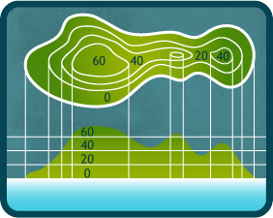
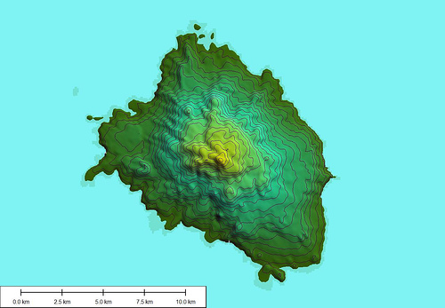
3D and contour representations

Slide 37
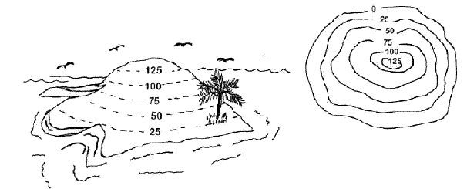
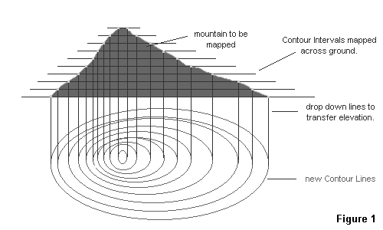
3D and contour representations

Slide 38
Contour representations of Orbitals with nodes : given their expression!

Slide 39
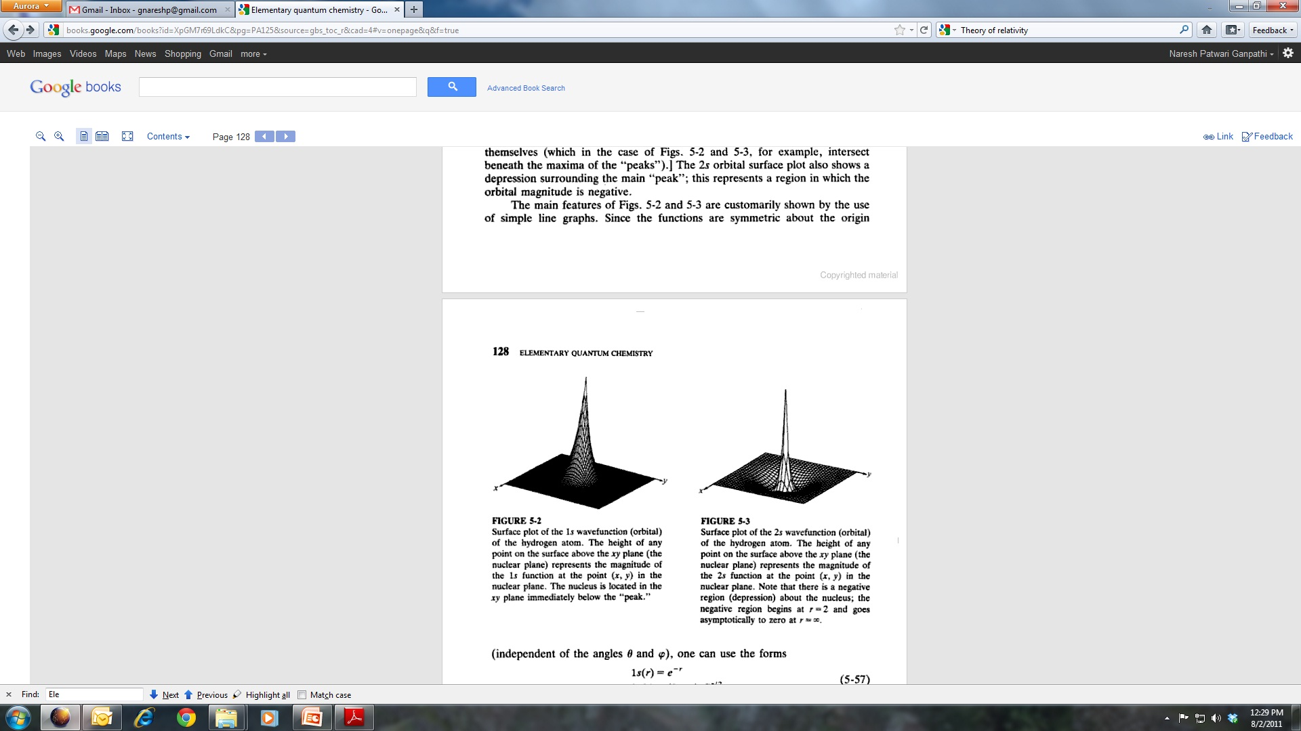
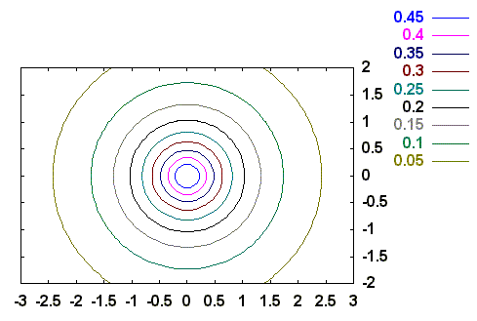
1s orbital

Slide 40
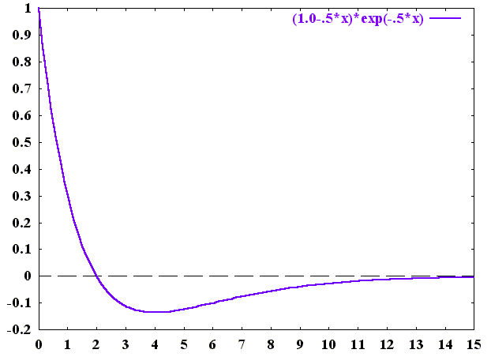
2s orbital
radial node
Y. U. Sasidhar

Slide 41
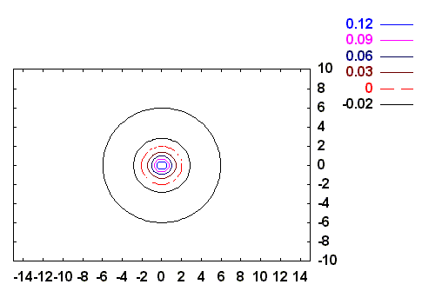
2s orbital
radial node
radial node
y/a
-
+
x/a
Y. U. Sasidhar

Slide 42
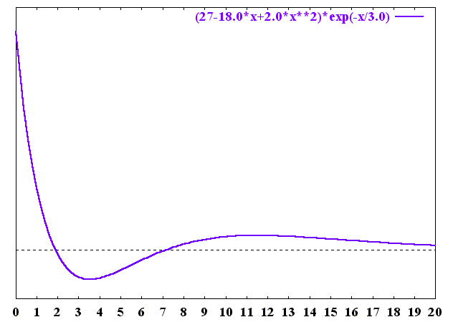
3s orbital
radial nodes
r/a

Slide 43
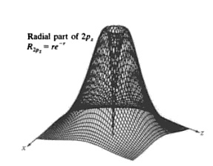
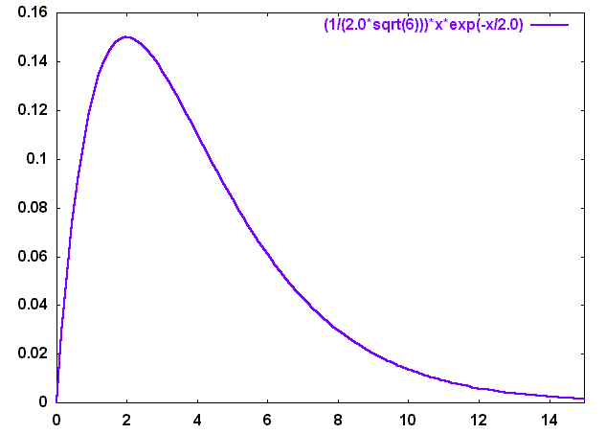
2p_{z} orbital
Angular Part
(2,1,0)
Radial Part starts with a zero at r=0; so does Ψ
No radial node !
Y. U. Sasidhar

Slide 44
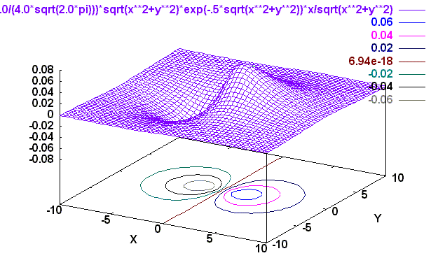
2p_{z} orbital
Angular Part
(2,1,0)
X
Z

Slide 45
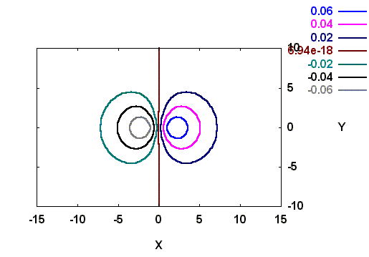
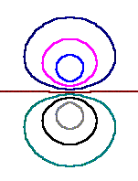
2p_{z} orbital
Angular node
z=0
same value
_
x/a
+
- ve contours
+ ve contours
z/a

Slide 46
2p_{z} orbital: Constant Probability Surface
+
_

Slide 47
2p_{z} orbital: Probability distribution as dots

Slide 48
2p Orbitals
Linear
combination

Slide 49
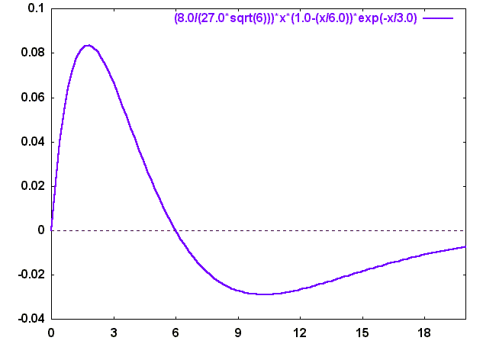
3p_{z} orbital
radial
node
R
r/a

Slide 50
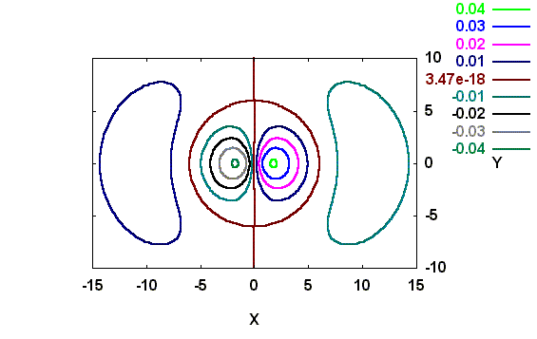
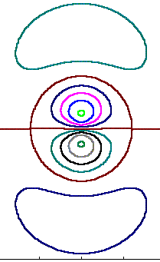
3p_{z} orbital
radial node
x/a
x/a
angular node
z/a
y=0 here

Slide 51
3pz orbital: Surface of constant probability

Slide 52
3p_{z} orbital: Probability distribution as dots

Slide 53
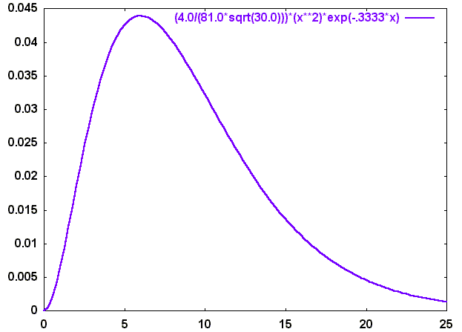
r/a

Slide 54

Angular nodes: x = ± y
-
+
+
y/a
-
x/a

Slide 55
Angular nodes: x = ± y
-
+
+
y/a
-
x/a

Slide 56

angular nodes: x=0, y=0
-
+
y/a
+
-
x/a

Slide 57

2 angular nodes
-
+
+
x/a
-
z/a

Slide 58
3dz² : Surface of constant probability

Slide 59
3dz² : Surface of constant probability with angular nodes

Slide 60
3dz² : Probability distribution as dots

Slide 61
4f₀

Slide 62
4f₀ : Nodal Surface in grey

Slide 63
is only a nickname
Full label:

Slide 64


Surface plots
Surface plot of the 3d_{z2} wavefunction (orbital) in the xz (or yz) plane for the hydrogen atom. The large hills correspond to the positive lobes and the small pits correspond to the negative lobes.
Surface plot of the (3d_{z2} )² the probability density associated with the 3d_{z2} orbital of the hydrogen atom. This figure is rotated with respect to the figure on the left so that the small hill will be clearly visible. Another smaller hill is hidden behind the large hill.
Surface plot of the 3d_{xy} wavefunction (orbital) in the xz plane for the hydrogen atom. The hills and the pits have same amplitude.
Surface plot of the (3d_{xy} )² the probability density associated with the 3d_{xy} orbital of the hydrogen atom. Pits in the figure to the left appear has hills.

Slide 65
Hydrogen Wavefunctions

Slide 66
Orbitals: External Structure

Slide 67

Orbitals: Internal Stucture

Slide 68
Hydrogen atom & Orbitals
Hydrogen atom has only one electron, so why bother about all these orbitals?
1. Excited states
Spectra
3. Many electron atoms

